Slide 1
Meeting 32

Slide 2
Agenda
Attempt on making the code faster
Summary of optim results so far
Next actions with the pilot study
Reading on some resampling papers

Slide 3
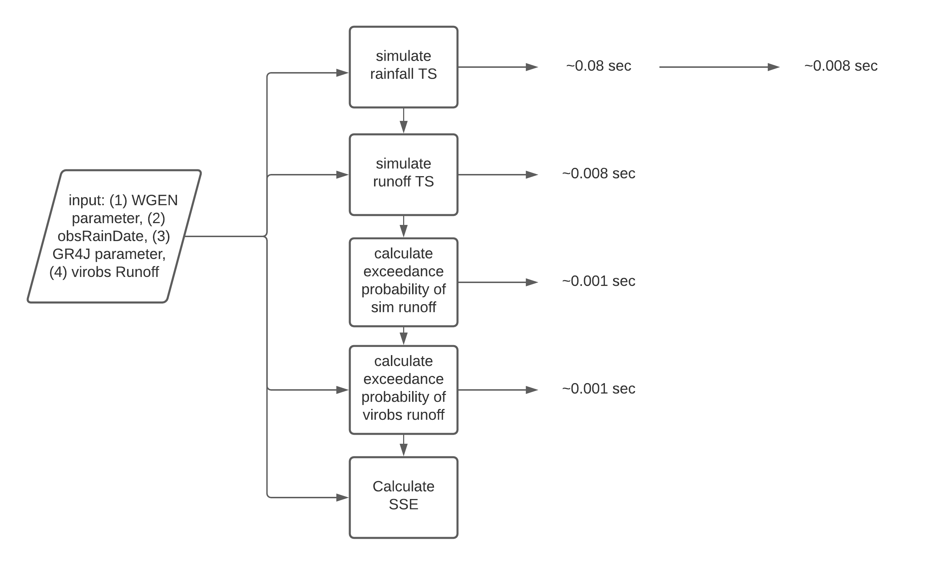
Faster code

Slide 4
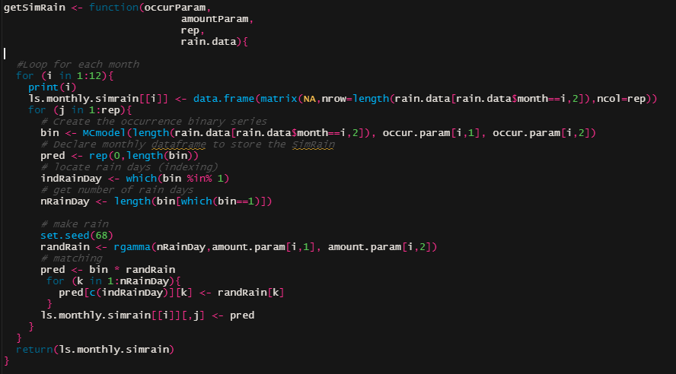
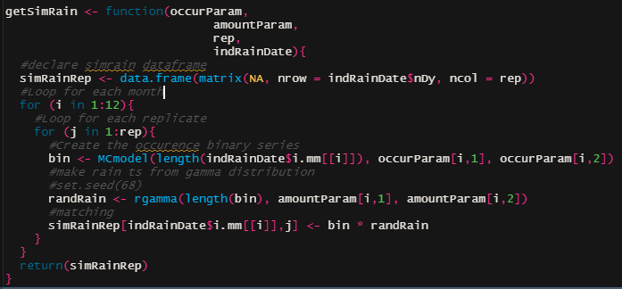
Faster code

Slide 5
optim results

Slide 6
Next actions
Try the relative error as the objective function.
i.e. taking the sum of the relative errors.
Simulating with multiple replicates.
Choosing site for the experiment.

Slide 7
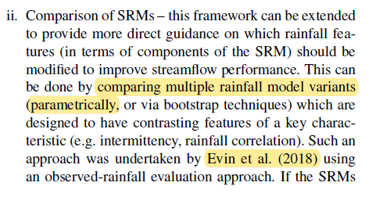
Reading
Non-paranetric method for daily rainfall simulation (using knn)
Bootstrapping

Slide 8
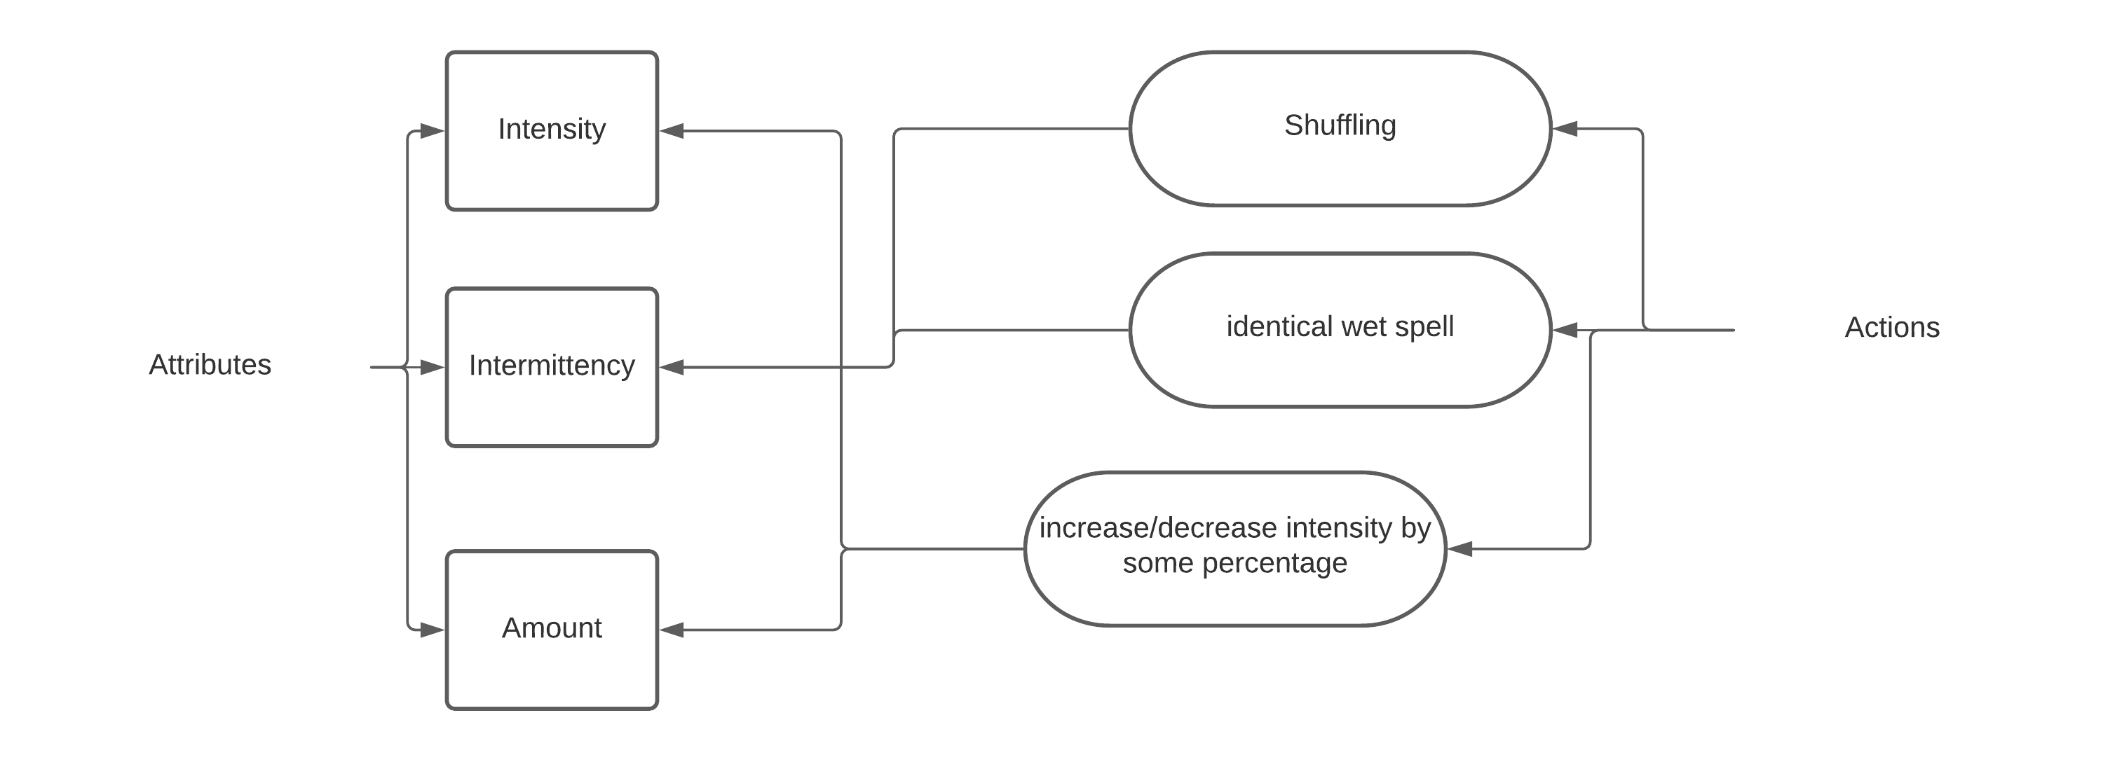
Reading

Slide 9
Tasks

